Slide 1
Family Plus
The Family Tree App

Slide 2
What is family plus?
Family Plus is an app which allows you to create and maintain your own family tree. You can add children, siblings and parents in the family tree.
As the app has not been fully developed yet and this is a prototype, the app only allows you to create a family tree and add children with it.

Slide 3
The goal of family plus
Family Plus is created to promote security and welfare amongst family. It aims to secure families from financial problems, medical problems, and outside threats by taking preventive and precautionary measures ahead in time. This app in the future can also be used by forthcoming generations for tracing their ancestors

Slide 4
Benefits and uses of the app
Family Plus allows you to create your family tree with the sole aim of promoting security amongst family members.
Anyone with an internet connection can enjoy the benefits of the app.
It can be used to track the location of individual’s family members.*
It can be used for sharing media(i.e, pictures, videos, etc).*
It can be used for chatting and sharing messages.*
*The feature has not been implemented as it is a prototype.

Slide 5
Features currently implemented in the prototype
The implemented features in the prototype are:
The ability to create an account with a registered username and password.
The ability to login with the registered username and password.
The ability to create a family tree and add only an individual’s children to the created family tree.

Slide 6
Features to be added as a full-fledged application
The following features will be added if the prototype is selected:
The ability add more relations, specifically siblings and parents,
More profile features such as profile picture, date of birth, gender, bio data, etc.
The ability to track one’s children
The ability to share photos and videos with people added to your family.
The ability to chat and make calls.
The ability to recover one’s account if they have forgotten the username or password.
More unplanned features to be added on the go.

Slide 7
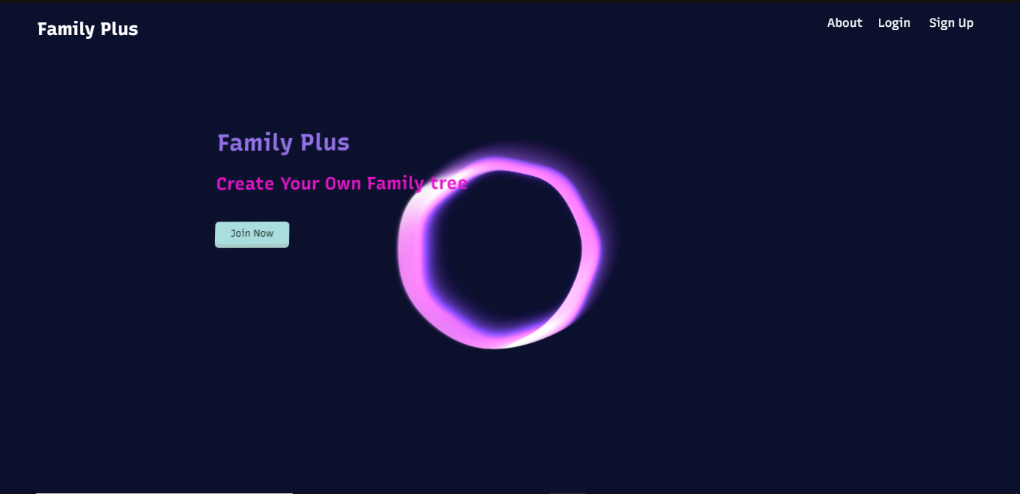
Screenshots of the application
The Title screen

Slide 8
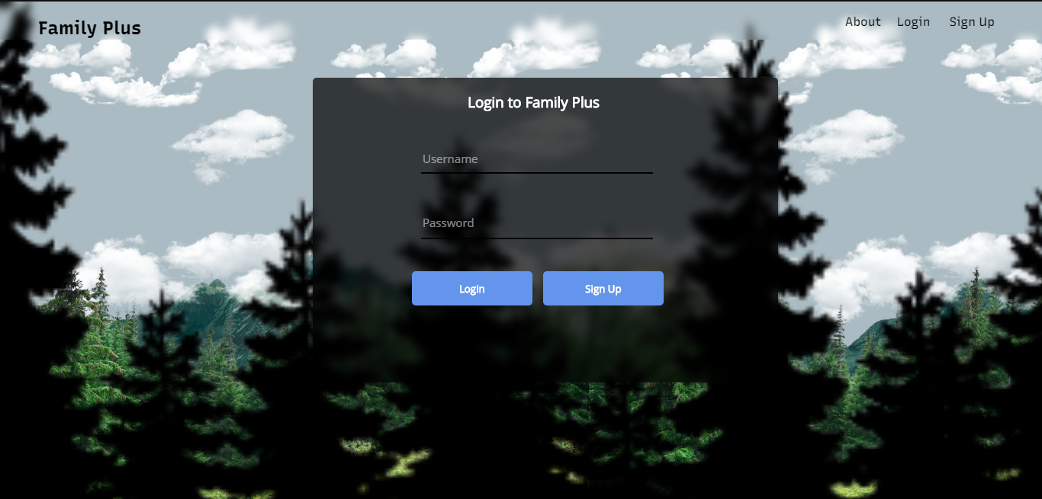
Screenshots
Login and Signup screen

Slide 9
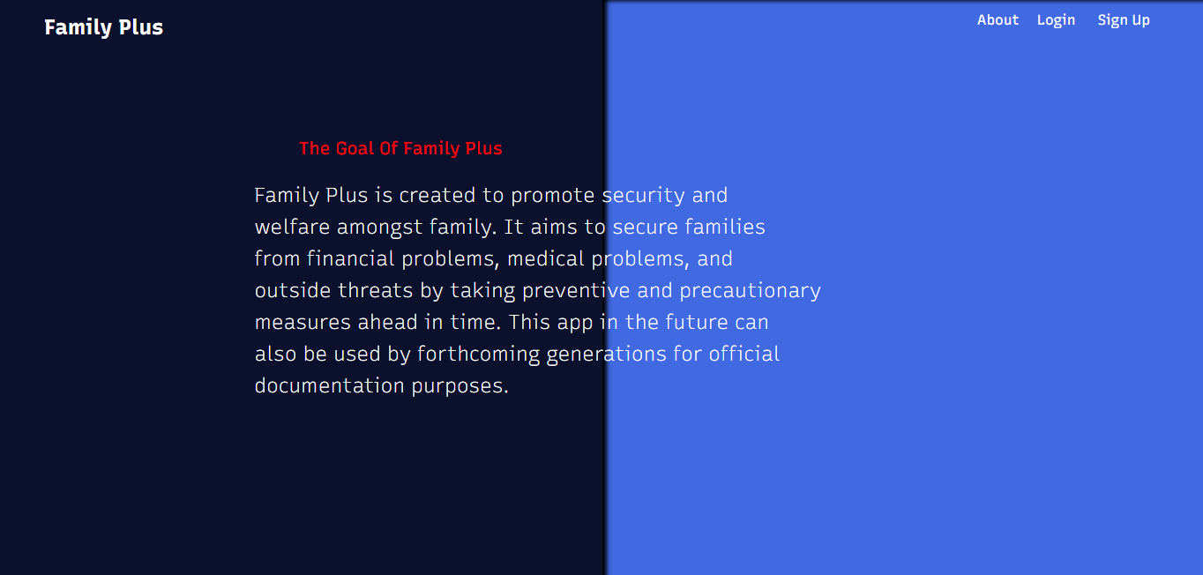
Screenshots
About screen

Slide 10
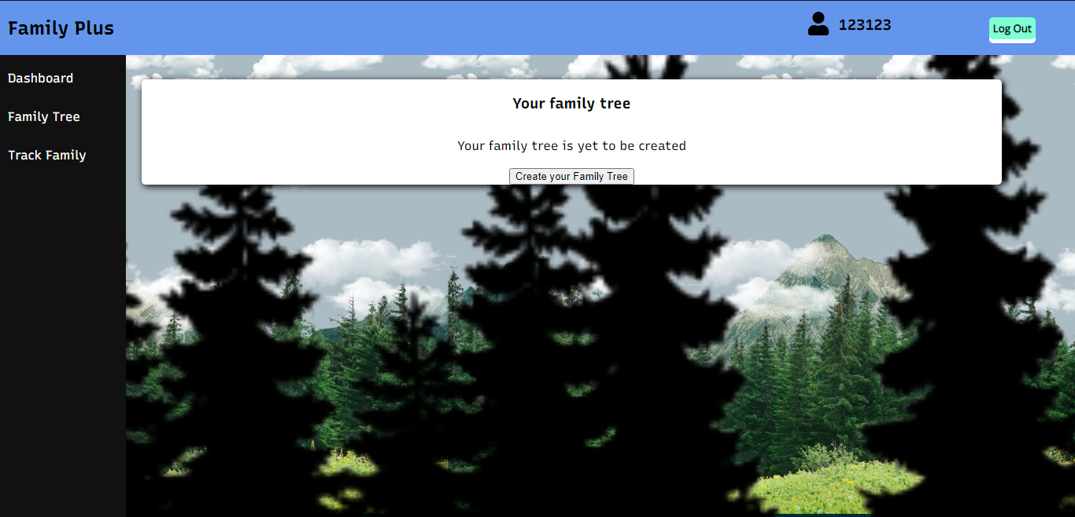
screenshots
Dashboard screen when a new user signs up

Slide 11
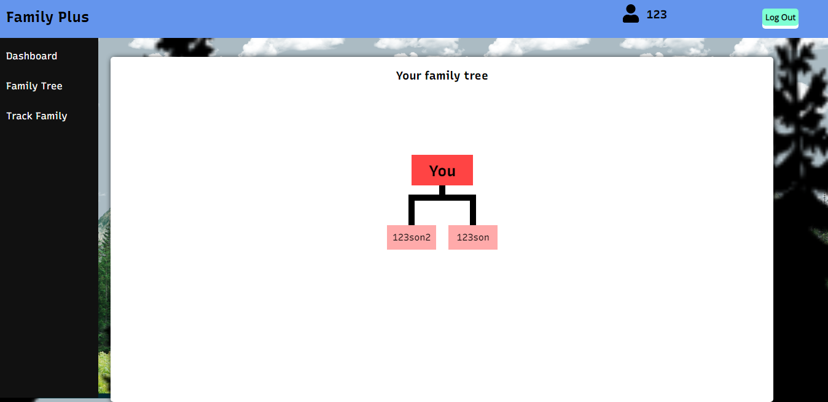
screenshots
Dashboard screen when a user has created a family tree

Slide 12
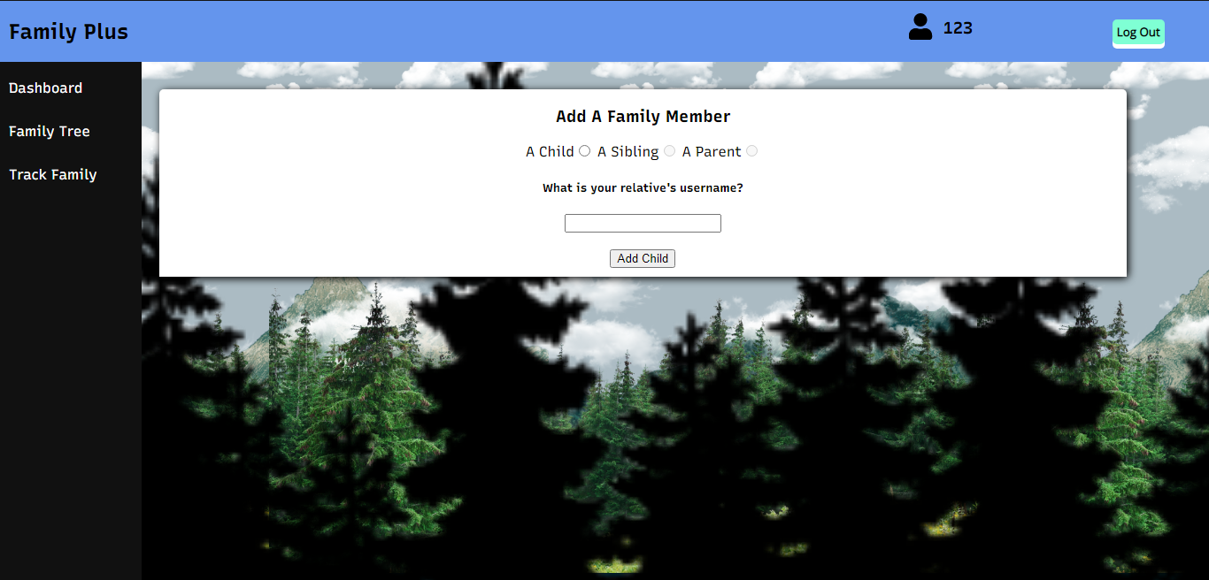
screenshots
Family Tree screen where user can create a family tree and add people

Slide 13
Development environment
The application is developed using the following tools:
Name | Tool Used
Front End | HTML, CSS, JavaScript
Database | Google Firebase
Repository | Github
Website Hosting | Github
IDE | Visual Studio Code

Slide 14
Thank You
Contact email: mohd.rizwan@gmail.com

